Slide 1
463.5 De-Identification
Computer Security II
CS463/ECE424
University of Illinois
Notes:
Some examples are inspired by slides of: Vitaly Shmatikov, Ninghui Li, Christine Task

Slide 2
Outline
De-Identification
Privacy metrics
Privacy in practice
Discussion

Slide 3
De-Identification
Suppose we have a dataset we would like to release
The dataset contains sensitive information about a set of individuals
We want to protect the privacy of those individuals
What about just removing the names?
Name | Sex | Age | Zip | Diagnosis (ICD-9)
Alice Smith | F | 37 | 61821 | 037, 651
Bob Johnson | M | 41 | 61820 | 823, 042
Carol Williams | F | 24 | 61803 | 010, 650
Dan Jones | M | 46 | 61706 | 823, 460
Elisabeth Brown | F | 50 | 61824 | 945

Slide 4
GIC incident
Group Insurance Commission (Massachusetts)
Release patient data of state employees (about 135,000 records)
De-identification of the dataset by removing names
[Sweeney02] re-identification of the governor
linking the dataset with the voter registration list
ZIP code
Birth date
Sex
GIC
voter registration
Uniqueness of demographics
(5 digit ZIP, birth date, sex) uniquely identifies over 87% of US population
Notes:
[Sweeney02]: Sweeney, Latanya. "k-anonymity: A model for protecting privacy." International Journal of Uncertainty, Fuzziness and Knowledge-Based Systems 10.05 (2002): 557-570.

Slide 5
AOL search logs incident
AOL released search logs of 650,000 users in Aug 2006
De-identification of the dataset by using pseudonyms (a unique number for each customer)
[New York Times 2006] Re-identified Thelma Arnold (user 4417749) through some of her searches:
"60 single men", "landscapers in Lilburn, Ga“
Also searched the names of some of her relatives, last name Arnold
Class action lawsuit in Sept 2006
AOL’s CTO resigned, two employees were fired
Search logs can still be downloaded from mirrors
Notes:
[NYT2006]: "A Face Is Exposed for AOL Searcher No. 4417749.“ http://select.nytimes.com/gst/abstract.html?res=F10612FC345B0C7A8CDDA10894DE404482
[CNET2006]: "AOL sued over Web search data release." http://www.cnet.com/news/aol-sued-over-web-search-data-release/

Slide 6
Netflix Prize incident
Dataset containing movie ratings of 500,000 users
De-identification by removing identifiers, using a randomly assigned ID in place of the customer ID
[NS08] Proposed new class of attacks target high dimensionality sparse datasets
Using 8 movie ratings (2 can be wrong) and dates (with up to 14 days error), 99% of users are uniquely identifiable
(Proof of concept) Re-identified 2 users by linking the Netflix dataset to IMDb using a sample of 50 IMDb users
Notes:
[NS08]: Narayanan and Shmatikov. "Robust de-anonymization of large sparse datasets." IEEE S&P 2008.
https://topclassactions.com/lawsuit-settlements/lawsuit-news/5480-checks-mailed-for-aol-search-data-class-action-settlement/
Tier 1 Payment: You are eligible for a payment of up to $50 if you:
Were an AOL member between March and May 2006, and Believe in good faith that your search data was made available for download from research.aol.com.
Tier 2 Payment: You are eligible for a payment of up to $100 if you:
Were an AOL member between March and May 2006, and Believe in good faith that your search data was made available for download from research.aol.com, and Either: 1) you have been identified from that data or 2) another person or company could be reasonably certain of your identity based on the data.

Slide 7
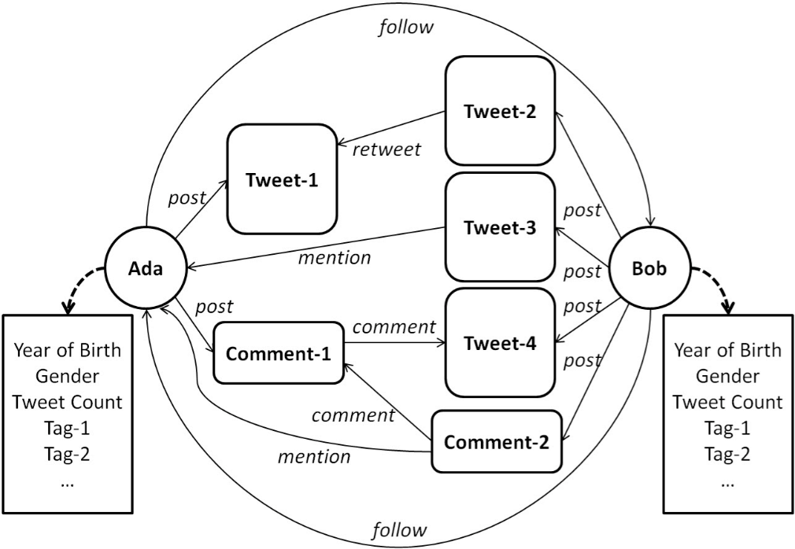
Heterogeneous Information Networks
“Privacy Risk in Anonymized Heterogeneous Information Networks.”
KDD Cup 2012 Dataset
Using a public dataset, the authors show de-anonymization (i.e., re-identification) attacks that exploit the heterogeneity of the network
Notes:
[ZXCGHW14]: Zhang, Aston, Xing Xie, Kevin Chen-Chuan, Carl A. Gunter, Jiawei Han, and XiaoFeng Wang. "Privacy Risk in Anonymized Heterogeneous Information Networks." EDBT 2014.

Slide 8
Re-identification Vectors
External Knowledge
E.g., voter registration, marriage registries
Unredacted free text
Can contain arbitrary data
High dimensionality, sparsity
More features
Large distance between data points

Slide 10
Types of disclosure
Identification disclosure
Reveals the target individual’s record
Attribute disclosure
Reveals one or more (possibly sensitive) attributes about the target individual
Can occur even
without identification disclosure
if the target individual’s record is not in the dataset (e.g., “smoking causes cancer”)
Membership disclosure
Reveals whether the target individual’s record was included in the dataset
Notes:
To assess privacy metrics, we have to consider what kind of disclosure can occur.
Which type of disclosure should be seen as privacy violation is subject to much debate.

Slide 11
k-anonymity
[Sweeney02] k-anonymity
Quasi-identifiers: attributes that can be used for linking with external information (e.g., ZIP, sex, birth date)
To satisfy k-anonymity: any sequence of quasi-identifiers must appear in at least k records
Name | Sex | Age | Zip | Diagnosis (ICD-9)
Alice Smith | F | 37 | 61821 | 037, 651
Bob Johnson | M | 41 | 61820 | 823, 042
Carol Williams | F | 24 | 61803 | 010, 650
Dan Jones | M | 46 | 61706 | 823, 460
Elisabeth Brown | F | 50 | 61824 | 945
Quasi-identifiers
Notes:
[Sweeney02]: Sweeney, Latanya. "k-anonymity: A model for protecting privacy." International Journal of Uncertainty, Fuzziness and Knowledge-Based Systems 10.05 (2002): 557-570.
Trick question: why don’t we just remove the quasi-identifiers?

Slide 12
Satisfying k-anonymity
Generalization
E.g., ZIP codes – 61802 -> 61XXX
E.g., Age – 47 -> [40, 49]
Suppression:
E.g., names
Is this 2-anonymous?
How about now?
Sex | Age | Zip | Diagnosis
* | [30-39] | 61XXX | Broken Leg
* | [40-49] | 61XXX | Cancer
* | [40-49] | 61XXX | Cancer
* | [30-39] | 61XXX | Tuberculosis
* | [20-29] | 61XXX | Heart Condition
No!

Slide 13
Other syntactic metrics
k-anonymity does not prevent attribute disclosure
E.g., if there is a quasi-identifier group among which all records contain an attribute that has a single value
l-diversity
Within each quasi-identifier group, there must be at least l distinct values for each attribute
t-closeness
The distance between the distribution of attributes within a quasi-identifier group and the overall distribution should not exceed t
Many others
Sex | Age | Zip | Diagnosis
* | [30-39] | 61XXX | Cancer
* | [30-39] | 61XXX | Cancer
* | [30-39] | 61XXX | Cancer
* | [30-39] | 61XXX | Broken Leg
* | [30-39] | 61XXX | Cancer
5-anonymous
2-diverse
Notes:
[Li07]: Li, Ninghui, Tiancheng Li, and Suresh Venkatasubramanian. "t-Closeness: Privacy Beyond k-Anonymity and l-Diversity." ICDE 2007.

Slide 14
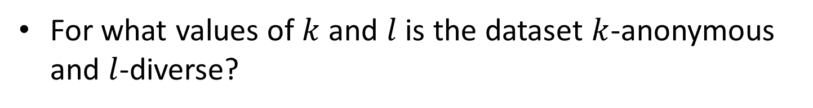
Example
For what values of $k$ and $l$ is the dataset $k$-anonymous and $l$-diverse?
Sex | Age | Diagnosis
M | [40-49] | Cancer
F | [40-49] | HIV
M | [30-39] | Asthma
F | [30-39] | Influenza
F | [30-39] | Cancer
M | [30-39] | Broken Leg
F | [30-39] | Tuberculosis
M | [40-49] | Tuberculosis
F | [40-49] | HIV
Quasi-identifier group | records | sensitive values
(M, [30-39]) | 2 | 2
(M, [40-49]) | 2 | 2
(F, [30-39]) | 3 | 3
(F, [40-49]) | 2 | 1
2-anonymous
1-diverse

Slide 15
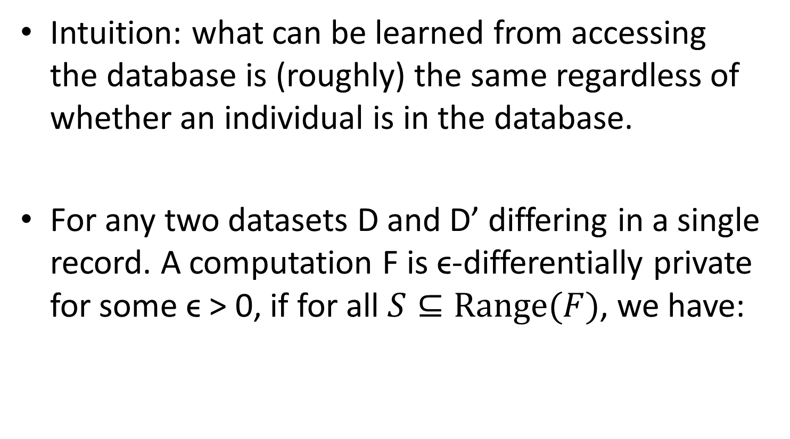
Differential Privacy [Dwork06]
Intuition: what can be learned from accessing the database is (roughly) the same regardless of whether an individual is in the database.
For any two datasets D and D’ differing in a single record. A computation F is ϵ-differentially private for some ϵ > 0, if for all $S⊆\text{Range}(F)$, we have:
Privacy budget
D’ includes the user’s record, D doesn’t
Notes:
[Dwork06]: Dwork, Cynthia. "Differential privacy." ICALP 2006.

Slide 16
One way to think about it
Name Attributes
Name Attributes
Alice
Bob
Carol
Alice
Bob
Carol
Vince
D
D’
F
R = F(D*)
Probability distribution over R should be “roughly” the same whether D* = D, or D* = D’.

Slide 17

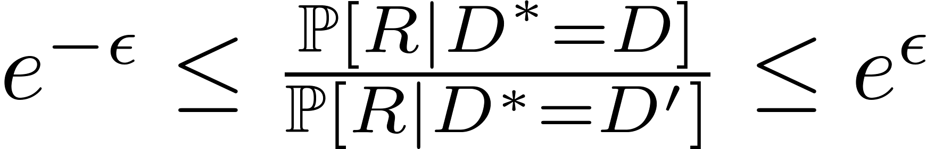
Slightly More Formally
R = F(D)
R = F(D’)
R
The probability distribution is over the random coins of F.
Note: e^{ϵ} ≈ 1+ϵ, for small ϵ > 0

Slide 18
Privatization
Idea: add noise
What noise distribution should we use?
How much noise to add?
The key concept is sensitivity of f, the function we want to compute
Generic way to get ϵ-differential privacy: Laplacian mechanism

Slide 19
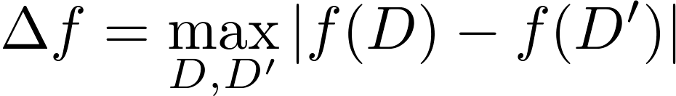
Sensitivity
Sensitivity measures how much an individual record can change the output, i.e., f(D*), in the worst case
E.g., counts have sensitivity 1, averages may have high sensitivity.
Notes:
Sensitivity is a worst case measure; it does not depend on the dataset, only on the function f.

Slide 20

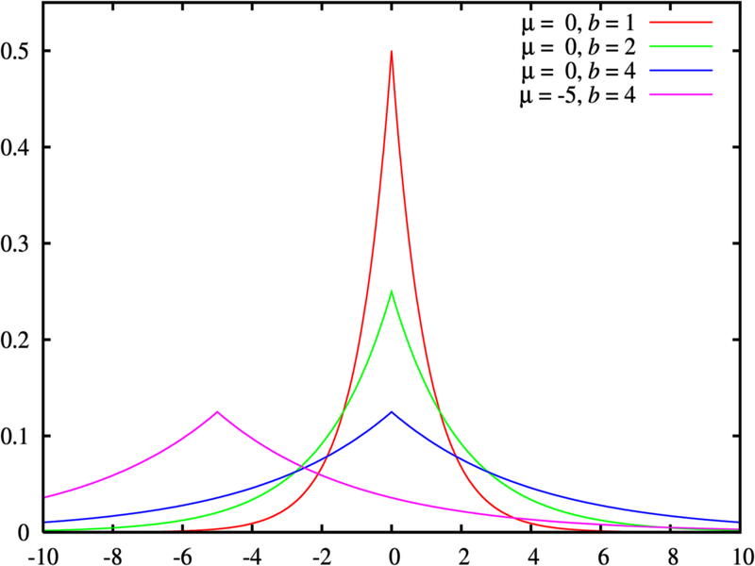
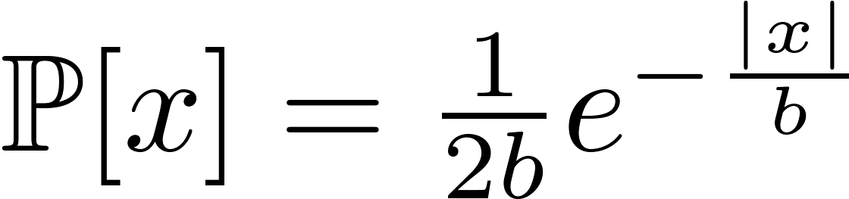
Laplacian Mechanism
Add noise from Laplace distribution
That is, release:
Laplace Distribution with mean 0
From Wikipedia.
Notes:
On average the amount of noise added grows proportionally to the sensitivity of the query, and inversely proportionally to the privacy budget.
Laplace distribution: with probability ½ -> add exponentially distributed noise, with probability ½ -> subtract exponentially distributed noise.

Slide 21
Why does it work?
Intuitively:
Name Attributes
Name Attributes
Name Attributes
Name Attributes
Name Attributes
Name Attributes
Name Attributes
Name Attributes
Name Attributes
Name Attributes
Name Attributes
Name Attributes
Alice
Bob
Carol
….
Alice
Bob
Carol
….
Alice
Bob
Carol
….
Alice
Bob
Carol
….
Alice
Bob
Carol
….
Alice
Bob
Carol
….
Alice
Bob
Carol
….
Alice
Bob
Carol
….
Alice
Bob
Carol
….
Alice
Bob
Carol
….
Alice
Bob
Carol
….
Alice
Bob
Carol
….
R = F(D₁)
R = F(D₄)
R = F(D₉)
R = F(D₆)
R = F(D₈)
R = F(D₂)
R = F(D₅)
R = F(D₇)
R = F(D₃)
R = F(D₁₁)
R = F(D₁₀)
R = F(D₁₂)
R* = F(D*)

Slide 22
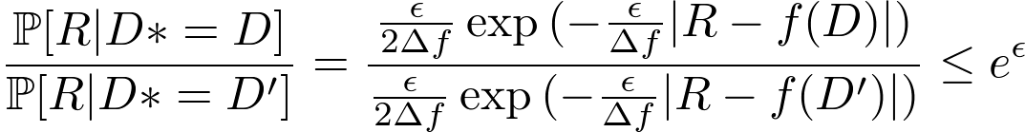
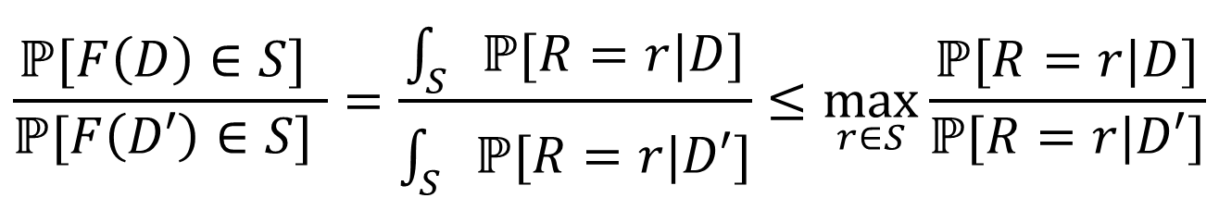
Why does it work?
Laplace Distribution with mean 0
From Wikipedia.
Mathematically:
$$\frac{ℙ[F\left(D\right)∈S] }{ℙ[F\left(D′\right)∈S] }=\frac{\int_{S}{ℙ[R=r|D]}}{\int_{S}{ℙ[R=r|D′]}}≤\max_{r∈S}{\frac{ℙ[R=r|D]}{ℙ[R=r|D′]}}$$
Notes:
Prob(R | D* = D) is the probability that the noise added from Laplace is exactly |R – f(D)|.
See Aaron Roth slides for more details: http://www.cis.upenn.edu/~aaroth/courses/slides/Lecture3.pdf.

Slide 23
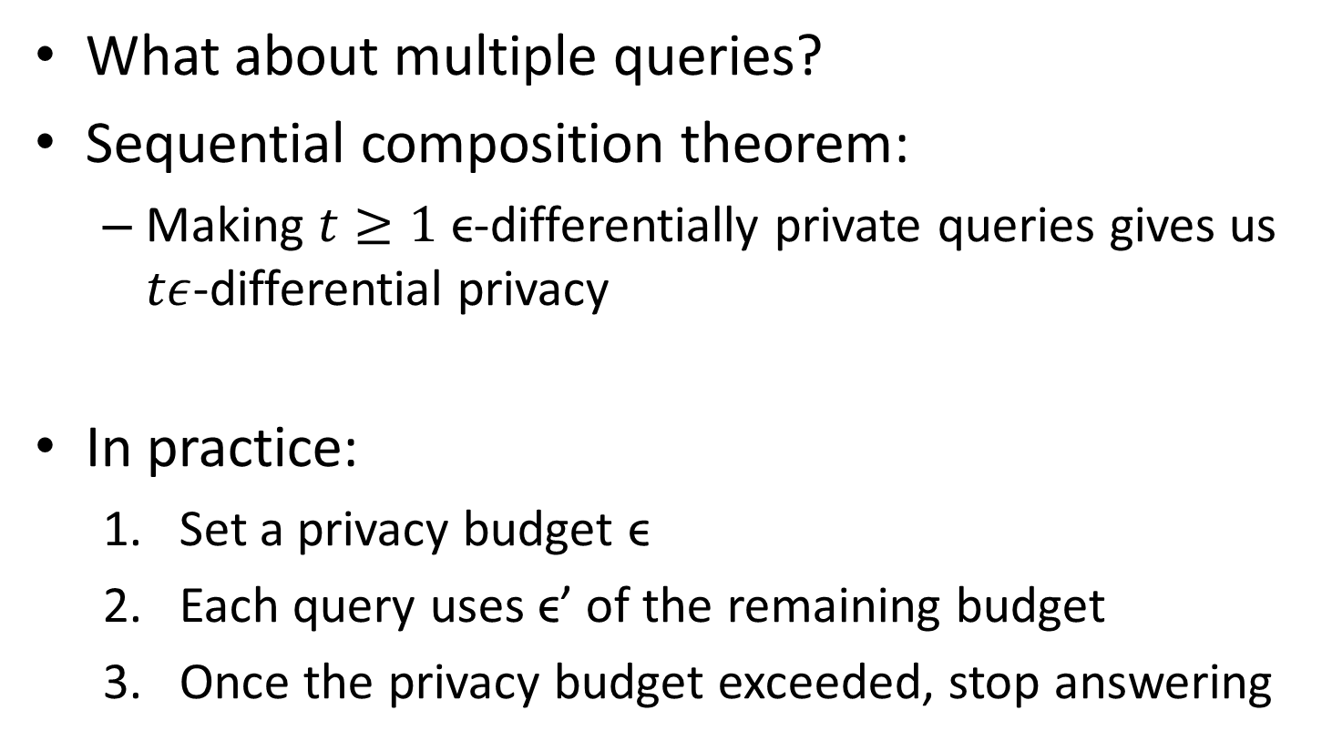
Composition
What about multiple queries?
Sequential composition theorem:
Making $t≥1$ ϵ-differentially private queries gives us $tε$-differential privacy
In practice:
Set a privacy budget ϵ
Each query uses ϵ’ of the remaining budget
Once the privacy budget exceeded, stop answering
Notes:
Rationale: prevents an adversary from averaging out the noise (has mean 0) by running the same query many times and averaging the results.

Slide 24
Using Differential Privacy
Advantages
Disadvantages
Differential Privacy is independent of the dataset; it is a property of the release mechanism
Provides strong theoretical guarantees
(Almost) no assumption on external knowledge
Sometimes requires adding too much noise; destroys utility of the data
Difficult to set the privacy budget ϵ
Notes:
Recently, it was discovered than an implicit assumption differential privacy makes on external knowledge is independence of the prior probability of each record being included in the dataset. (See D. Kifer and A. Machanavajjhala. “No free lunch in data privacy.” In SIGMOD, pages 193–204, 2011.)

Slide 26
Privacy in Practice
So far, k-anonymity and differential privacy have seen little use in practice
adding noise or modify the dataset may not be acceptable from a utility point of view
In practice:
Legal considerations, e.g., HIPAA Privacy Rule
Data Use Agreements (DUAs)

Slide 27
HIPAA
Health Insurance Portability and Accountability Act (HIPAA) 1996
In particular, addresses security and privacy of health data
HIPAA Privacy Rule
Two options for de-identification
Safe Harbor: redaction of 18 sensitive attributes
Expert Determination: e.g., statistician certifies risk of re-identification is “small”

Slide 28
Terminology
Protected Health Information (PHI): identifying information about
an individual’s physical or mental health
an individual’s provision of health care
E.g., laboratory report, medical bill
Covered Entity:
Health care provider
Health care clearinghouse
Health plan
Standard de-identification of PHI:
information is not individually identifiable
there is no reasonable basis to believe that re-identification can occur
Notes:
De-identification guidelines of health information with respect to HIPAA.
[hhs.gov]: http://www.hhs.gov/ocr/privacy/hipaa/understanding/coveredentities/De-identification/guidance.html

Slide 29
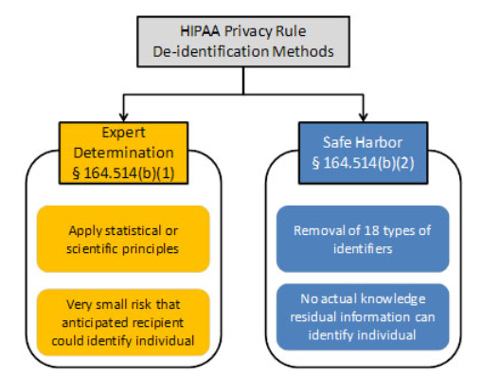
HIPAA De-Identification
figure from [hhs.gov]
Notes:
De-identification guidelines of health information with respect to HIPAA.
[hhs.gov]: http://www.hhs.gov/ocr/privacy/hipaa/understanding/coveredentities/De-identification/guidance.html

Slide 30
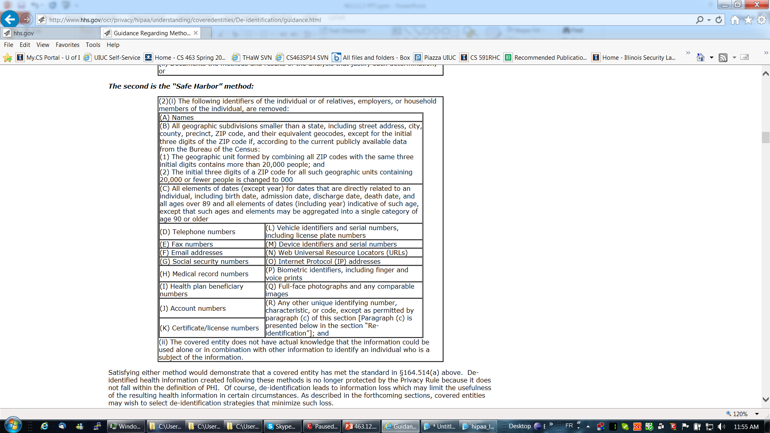
Safe Harbor
Notes:
Figure from [hhs.gov]: http://www.hhs.gov/ocr/privacy/hipaa/understanding/coveredentities/De-identification/guidance.html
Note: redaction can be encryption.

Slide 31
Expert Determination
Who is an expert?
A person who has experience with accepted techniques for de-identification
What are the principles used?
Replicability
Data source availability
Distinguishability
What is the remaining re-identification risk?
Must be very small
Notes:
De-identification guidelines of health information with respect to HIPAA.
[hhs.gov]: http://www.hhs.gov/ocr/privacy/hipaa/understanding/coveredentities/De-identification/guidance.html
Replicability: high (e.g., demographic information); low (e.g., blood pressure, glucose level)
Data source availability: high (e.g., marriage registries, voter registration); low (lab results)
Distinguishability: high (e.g., <5 digit ZIP codes, birth date, sex>, uniquely identifies over 87% of the US population); low (<3 digit ZIP codes, birth date, sex>, uniquely identifies less than 1% of the US population)

Slide 32
Data Use Agreements
HIPAA Privacy Rule allows a covered entity to disclose PHI in a limited dataset
Limited dataset:
PHI that excludes 16 categories of direct identifiers (that may not be disclosed), e.g., name, SSN, phone number; but may include, e.g., elements of date, city, ZIP.
Data use agreement for the covered entity and the recipient of the limited dataset; it must
specify use and disclosure of the limited dataset
identify who is allowed to use the limited dataset
require that the recipient
will not use the dataset in a way that is not permitted by the DUA
will use safe guards to prevent disclosure of the dataset
will not identify the information or contact the individuals
Notes:
HIPAA Privacy Rule and DUAs: [nih.gov] http://privacyruleandresearch.nih.gov/pr_08.asp
In a limited dataset, 16 categories of direct identifiers (out of the 18 categories required for de-identification) must be redacted; but the remaining two: e.g., elements of dates, city / town, may remain in the information disclosed.

Slide 34
References
[Sweeney02]: Sweeney, Latanya. "k-anonymity: A model for protecting privacy." International Journal of Uncertainty, Fuzziness and Knowledge-Based Systems 10.05 (2002): 557-570.
[NS08]: Narayanan and Shmatikov. "Robust de-anonymization of large sparse datasets." IEEE S&P 2008.
[Dwork06]: Dwork, Cynthia. "Differential privacy." ICALP 2006.

Slide 35
Discussion Questions
[Homer et al. 08] Genome-Wide Association Study (GWAS)
Study looks at SNPs of a population - link those to a disease
Two groups: control group, and disease group
Aggregate statistics can disclose membership
Attack requires genome of the target individual
What should be considered a privacy violation?
attribute disclosure?
membership disclosure?
something else?
(Recall that attribute disclosure can happen even when the target individual is not in the dataset, e.g., “smoking causes cancer.”)
Notes:
[Homer et al. 08]: N. Homer, S. Szelinger, M. Redman, D. Duggan, W. Tembe, J. Muehling, J. V. Pearson, D. A. Stephan, S. F. Nelson, and D. W. Craig. "Resolving individuals contributing trace amounts of dna to highly complex mixtures using high-density snp genotyping microarrays." PLoS Genet, 2008.

Slide 36
Discussion Questions
What techniques would you use to de-identify a dataset?
technical (e.g., k-anonymity, differential privacy)?
legal (e.g., DUAs)?
both?

